Slide 1
Modern Data Infrastructure
Pravin Y Pawar
Adapted from
Data Pipelines Pocket Reference
By James Densmore

Slide 2
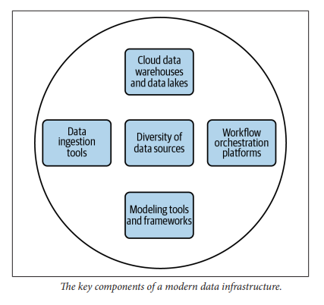
Key components of modern data infrastructure
No single right way to design analytics ecosystem or choose products and vendors
Before deciding on products and design for building data pipelines,
it’s worth understanding what makes up a modern data infrastructure

Slide 3
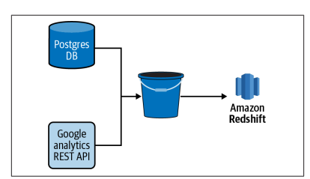
Diversity of Data Sources
Source Systems
The majority of organizations have dozens, if not hundreds, of data sources
that feed their analytics endeavors
Typical for an analytics team to ingest data from source systems
that are built and owned by the organization as well as from third-party tools and vendors
For example, an ecommerce company might
store data from their shopping cart in a PostgreSQL database behind their web app
also use a third-party web analytics tool such as Google Analytics to track usage on their website
combination of the two data sources is required to get a full understanding of customer behavior leading up to a purchase
A data pipeline that ends with an analysis of such behavior starts with the ingestion of data from both sources.

Slide 4
Ingestion Interface and Data Structure
Data Ingestion - extracting data from one source and loading it into another
When building a new data ingestion
Essential to know how to get data in and in what form
First, what is the interface to the data?
A database behind an application, such as a Postgres or MySQL database
A layer of abstraction on top of a system such as a REST API
A stream processing platform such as Apache Kafka
A shared network file system or cloud storage bucket containing logs, comma-separated value (CSV) files, and other
flat files
A data warehouse or data lake
Data in HDFS or HBase database
In addition to the interface, the structure of the data will vary.
JSON from a REST API
Well-structured data from a MySQL database
JSON within columns of a MySQL database table
Semi-structured log data
CSV, fixed-width format (FWF), and other flat file formats
JSON in flat files
Stream output from Kafka
Each interface and data structure presents its own challenges and opportunities

Slide 5
Cloud Data Warehouses and Data Lakes
Three things transformed the landscape of analytics and data warehousing over the last 10 years
All related to the emergence of the major public cloud providers (Amazon, Google, and Microsoft)
The ease of building and deploying data pipelines, data lakes, warehouses, and analytics processing in the cloud
Continued drop-in storage costs in the cloud
The emergence of highly scalable, columnar databases, such as Amazon Redshift, Snowflake, and Google Big Query
These changes breathed new life into data warehouses and introduced the concept of a data lake!
A data warehouse is a database where data from different systems is stored and modeled to support analysis
and other activities related to answering questions with it
Data in a data warehouse is structured and optimized for reporting and analysis queries
A data lake is where data is stored, but without the structure or query optimization of a data warehouse
likely contain a high volume of data as well as a variety of data types
There is a place for both data warehouses and data lakes in the same data ecosystem, and data pipelines often
move data between both.

Slide 6
Data Ingestion Tools
The need to ingest data from one system to another is common to nearly all data pipelines
data teams must contend with a diversity of data sources from which to ingest data from
A number of commercial and open source tools are available in a modern data infrastructure.
Singer
Stitch
Fivetran
Despite the prevalence of these tools,
some teams decide to build custom code to ingest data
Some even develop their own frameworks
Reasons vary by organization but are often related to
cost, a culture of building over buying, and concerns about the legal and security risks of trusting an external vendor.
need to assess the value of a commercial solution is to make it easier for data engineers to build data ingestions
into their pipelines or to enable non-data engineers (such as data analysts) to build ingestions themselves
Data ingestion is traditionally both the extract and load steps of an ETL or ELT process
Some tools focus on just these steps, while others provide the user with some transform capabilities as well

Slide 7
Data Transformation and Modeling Tools
Pipelines are also made up of tasks that transform and model data for new purposes
such as machine learning, analysis, and reporting
terms often used interchangeably
Data transformation
Transforming data is a broad term that is signified by the T in an ETL or ELT process
A transformation can be something
as simple as converting a timestamp stored in a table from one time zone to another
a more complex operation that creates a new metric from multiple source columns that are aggregated and filtered through some business logic
Data modeling
Data modeling is a more specific type of data transformation
A data model structures and defines data in a format that is understood and optimized for data analysis
A data model is usually represented as one or more tables in a data warehouse

Slide 8
Data Transformation and Modeling Tools(2)
Data Transformation Tools
Some data ingestion tools provide some level of data transformation capabilities, but these are often quite
simple
for the sake of protecting personally identifiable information (PII) it may be desirable to turn an email address into a hashed value
For more complex data transformations and data modeling, find it desirable to seek out tools and frameworks
specifically designed for the task, such as dbt
Additionally data transformation is often context-specific and can be written in a language familiar to data
engineers and data analysts, such as SQL or Python.
Data modeling Tools
typically defined and written in SQL or via point-and-click user interfaces
SQL is a highly accessible language that is common to both data engineers and analysts
empowers the analyst to work directly with the data and optimize the design of models for their needs
used in nearly every organization, thus providing a familiar entry point for new hires to a team
In most cases, choosing a transformation framework that supports building data models in SQL rather than via a
point-and click user interface is desirable!

Slide 9
Workflow Orchestration Platforms
As the complexity and number of data pipelines in an organization grows
it’s important to introduce a workflow orchestration platform to data infrastructure
manages the scheduling and flow of tasks in a pipeline
Imagine a pipeline with a dozen tasks ranging from
data ingestions written in Python
data transformations written in SQL
that must run in a particular sequence throughout the day
not a simple challenge to schedule and manage dependencies between each task
There are numerous workflow orchestration platforms available to alleviate the pain
Apache Airflow, Luigi, and AWS Glue, are designed for more general use cases and are thus used for a wide
variety of data pipelines
Kubeflow Pipelines, are designed for more specific use cases and platforms (machine learning workflows built on
Docker containers in the case of Kubeflow Pipelines

Slide 10
Customizing Data Infrastructure
It’s rare to find two organizations with exactly the same data infrastructure
Most pick and choose tools and vendors that meet their specific needs and build the rest on their own
many more come to market each year
Depending on the culture and resources in organization,
may be encouraged to build most of data infrastructure on their own
or to rely on SaaS vendors instead
Regardless of which way to lean on the build versus-buy scale
need to build the high-quality data infrastructure necessary to build high-quality data pipelines
Most important is understanding constraints (dollars, engineering resources, security, and legal risk tolerance) and the resulting trade-offs!

Slide 11
Thank You!
In our next session:

